Slide 1
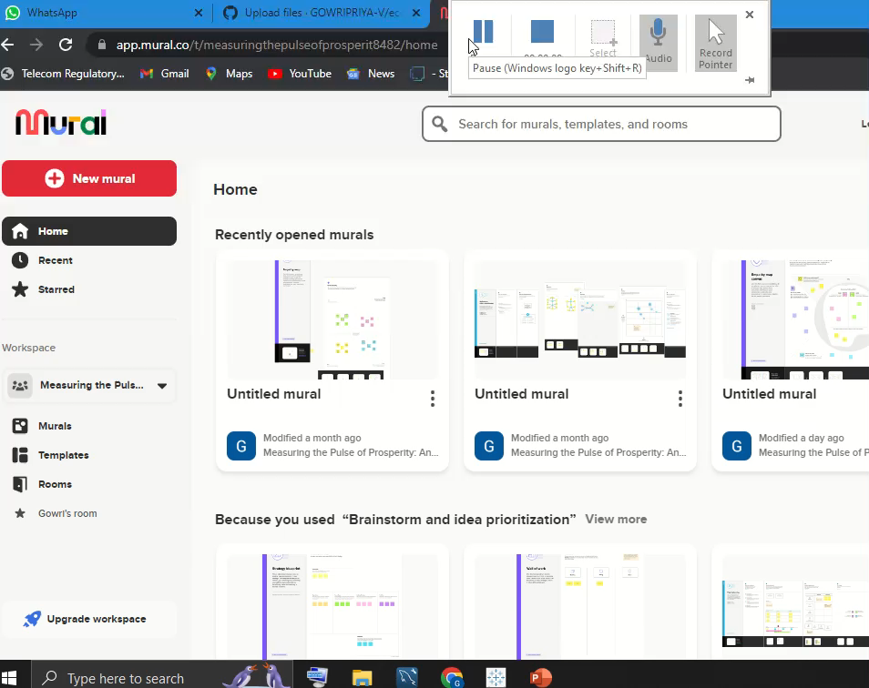

Measuring the Pulse of Prosperity An Index of Economic Freedom Analysis

Slide 2
Team nm id: AF628F67C364AC9A34E411D6F0EE389C
Team leader : Gowripriya.v
Team Members:
1.Haripriya.k
2.Jeevitha.m
3.Helina.k

Slide 3
economic freedom analysis conclution
The key ingredients of economic freedom are personal choice, voluntary exchange, freedom to compete in markets, and protection of person and property. Institutions and policies are consistent with economic freedom when they allow voluntary exchange and protect individuals and their property.

Slide 4


